Slide 1
Time series analysis: tsla stock
Jonathan Cheung

Slide 2
agenda
Project Focus
Brief overview of Tesla
Data Retrieval, Cleaning and Preprocessing
Time Series Analysis
Forecasting (ARIMA / LSTM)
Findings + Next Steps

Slide 3
Focus
Studying the workings of time series analysis as a tool
Exactly how hard is it to forecast stock price?
Not concerned with due diligence at this time

Slide 4
Overview of TSLA
Full-Electric commercial motor vehicles
IPO on June 29, 2010 at $17/share
Quarterly financial reports typically in April, July, October and January.
Recent major events:
Profitability reported in Q1 despite COVID (Apr 29, 2020)
Early scheduled delivery of the new Model Y
$1.8B increase in cash position to $8.1B total

Slide 5
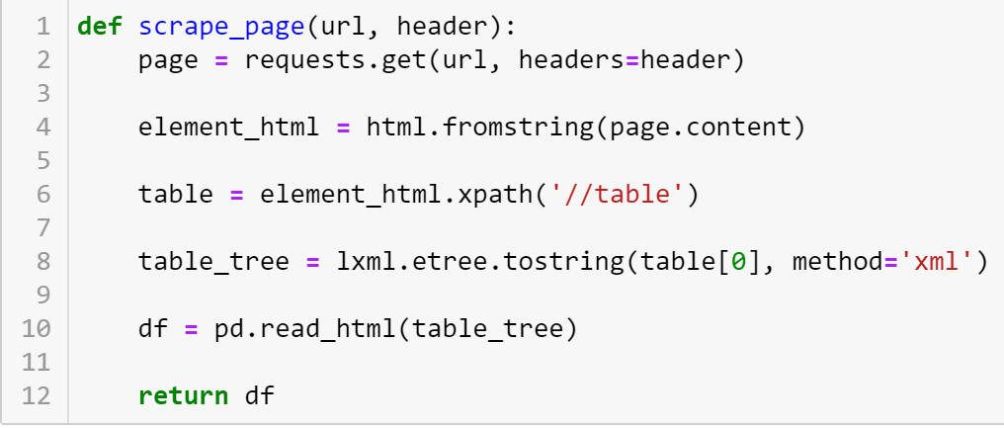
Scraping with HTML/Lxml
Request page
Parse contents to HTML object
Use xpath to search for tag of interest (first table)
Convert to string and pd.read_html returns list of dataframes

Slide 6
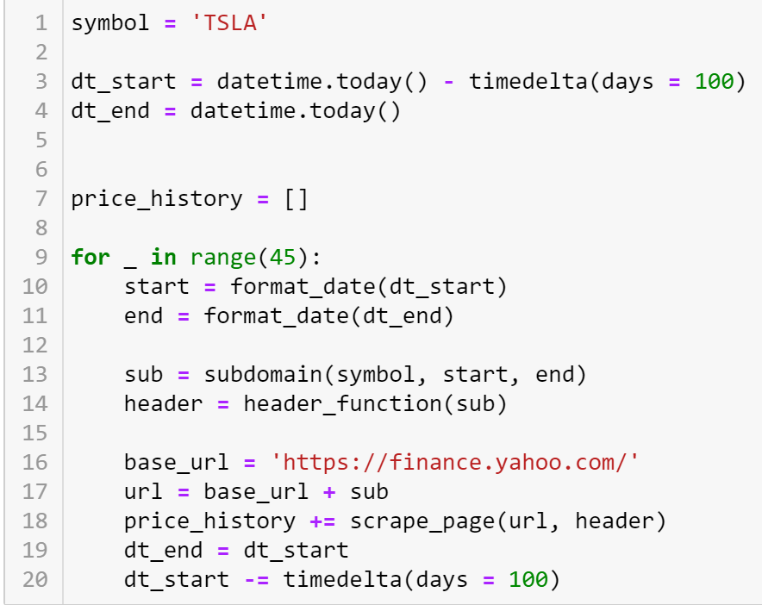
Scraping cont.
Yahoo only returns 100 rows of data per request
Looped 45 times to get all stock data from IPO to present

Slide 7
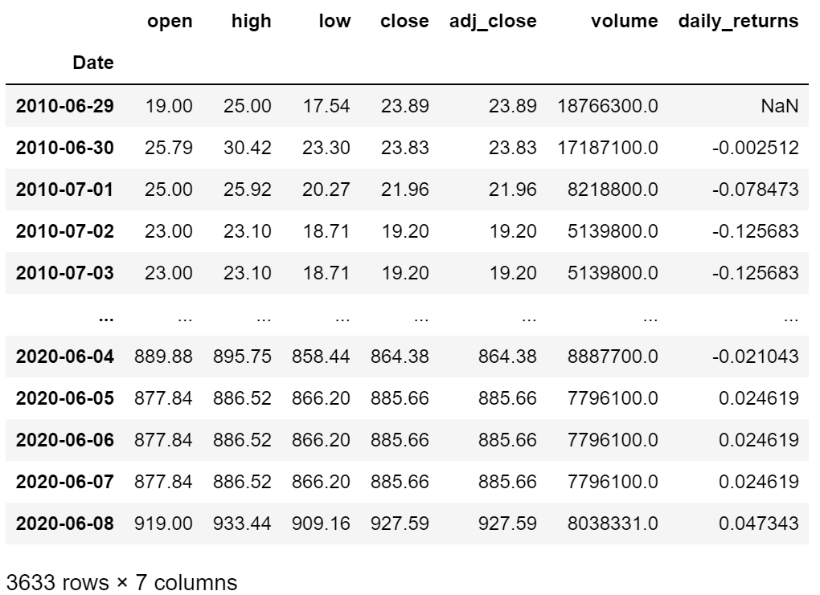
Cleaning and preprocessing
Data was mostly clean
Resampled by “Day” to remove some duplicate rows
Performed front fill to fix gaps in index frequency (filled weekends with Friday data)

Slide 8
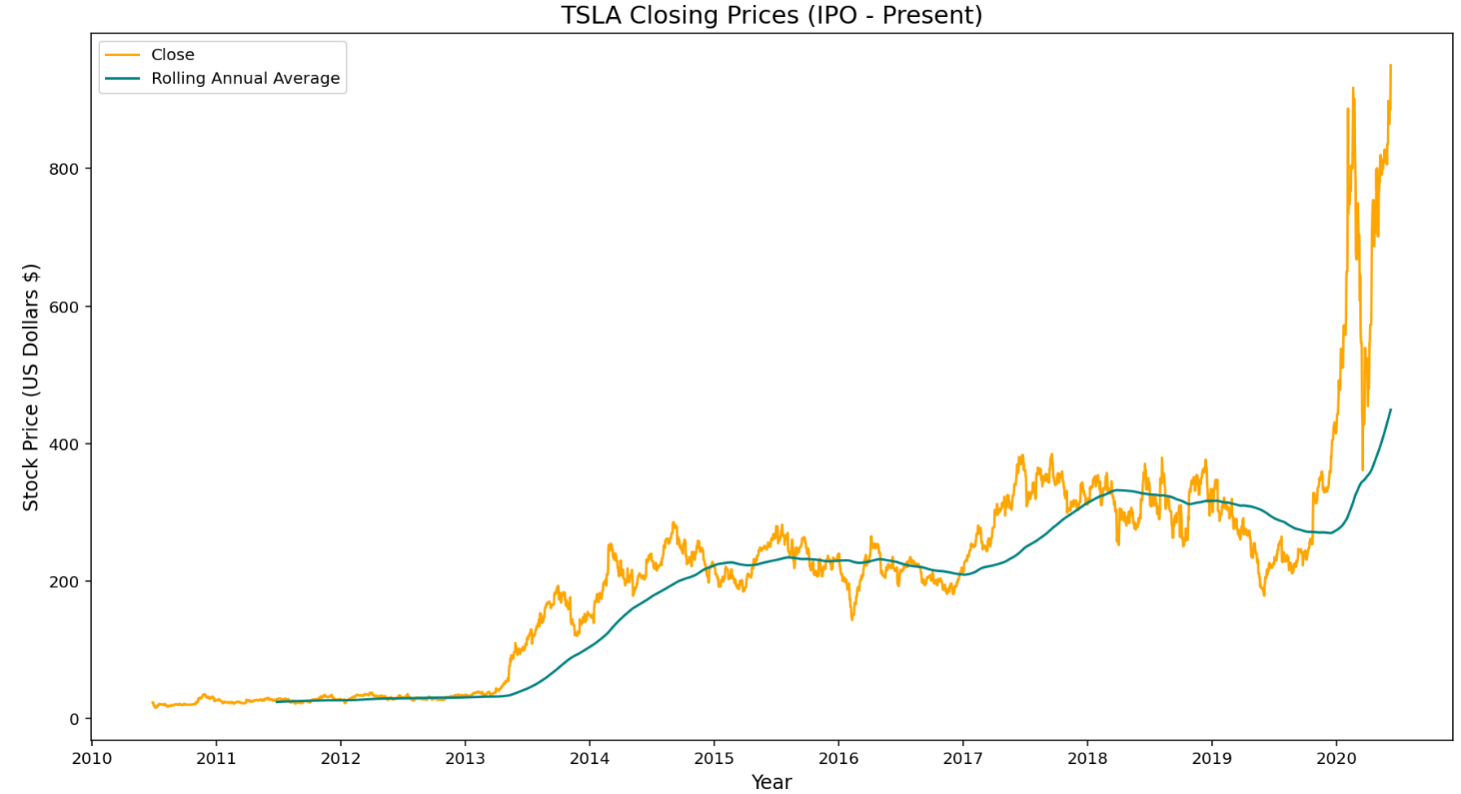
Time Series Analysis
Non-linear trend
Variability increased dramatically over time
In 2013, Musk announced Tesla was profitable for the first time ever

Slide 9
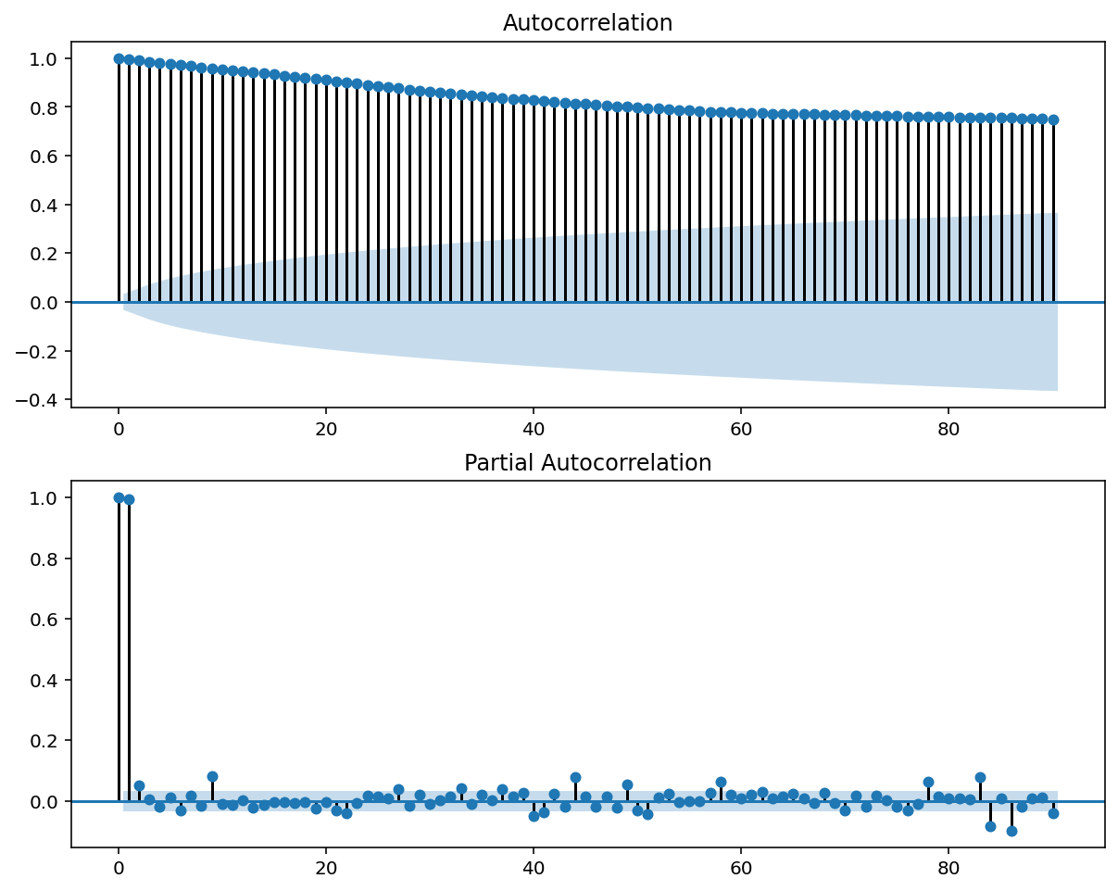
Time Series Analysis cont.
Non-stationary data evidenced by slow decay in ACF plot with 90 lags (confirmed with ADFuller test)
No signs of seasonality in our PACF plot

Slide 10
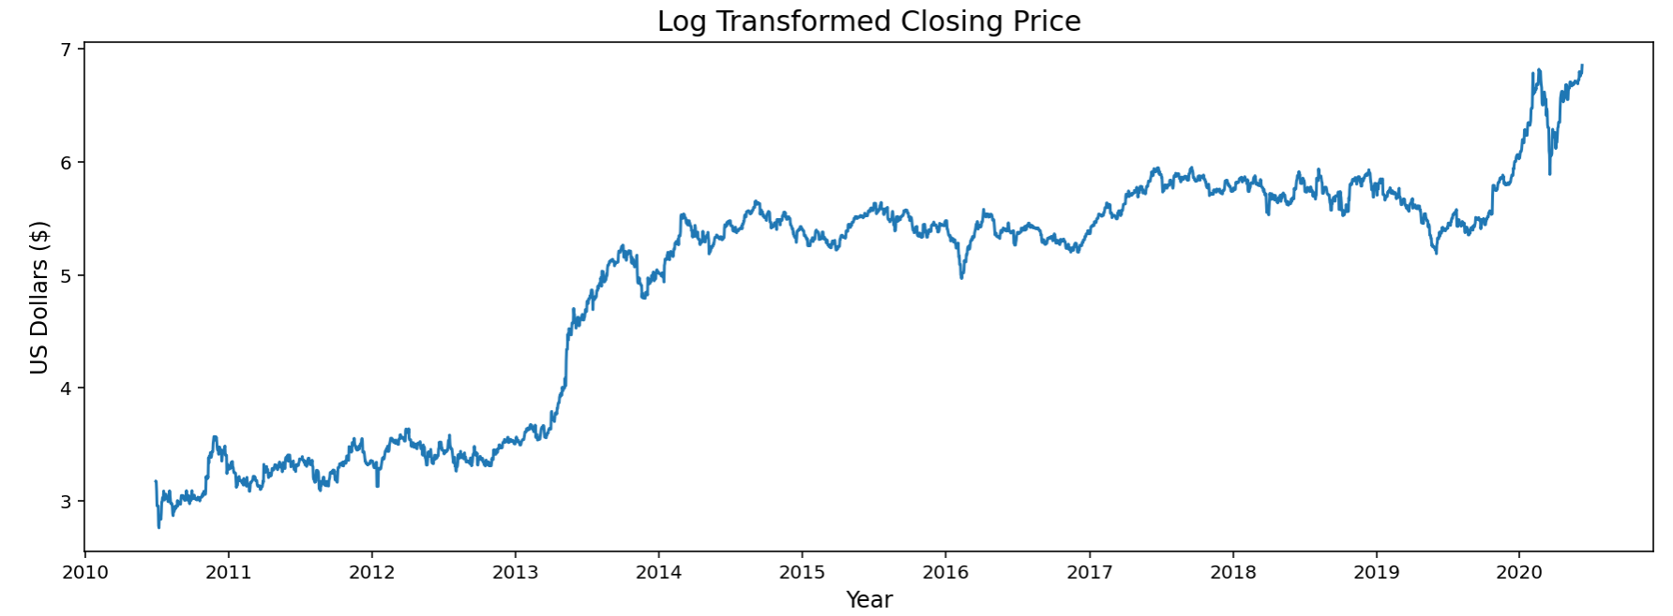
Time Series Analysis cont.
Log transformed closing price to decrease variability and noise
Adjusts for inflation and linearizes trend
5 natural log units over 10 years translates to an average annual increase of 50%

Slide 11
Significance of stationarity
The statistical properties of a process generating a time series does not change over time (!!!!)
Not that the series doesn’t change over time, rather, the way the series changes does not change over time.
Time series data is merely a single run of a stochastic process. Stationarity allows us to treat this single process as if it were replicable.
We’re able to predict the way the series changes
Assumptions for statistical inference are satisfied

Slide 12
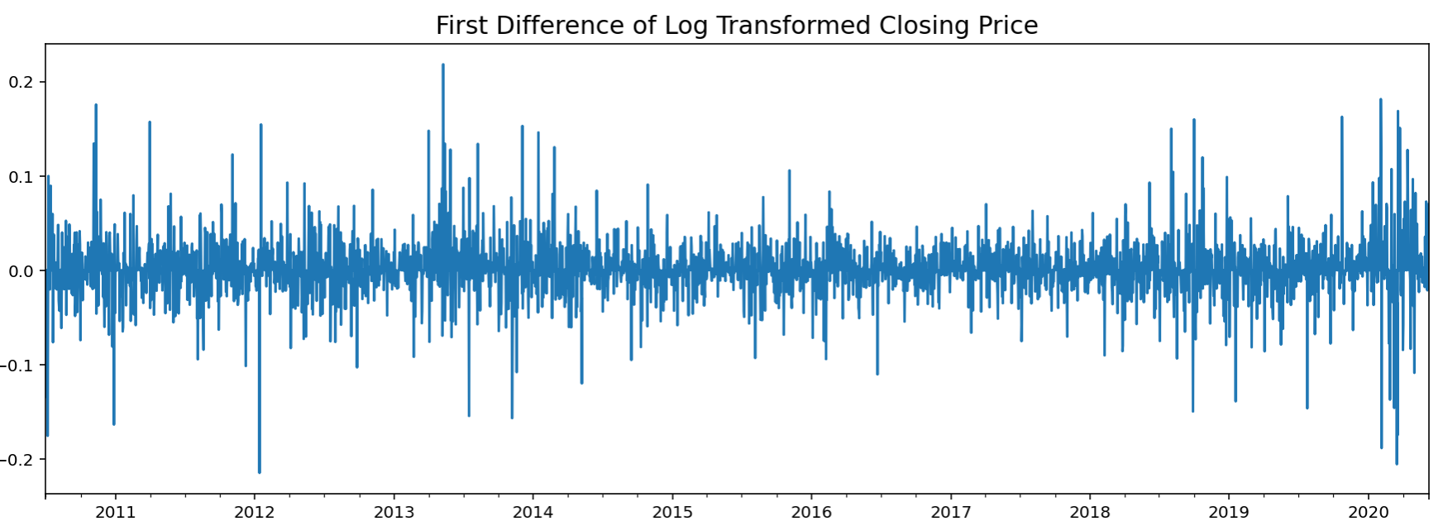
Time Series Analysis cont.
First difference of log transformed data is essentially the percent difference (or percent daily returns) of the original data
Mostly ranges between +- 10%

Slide 13
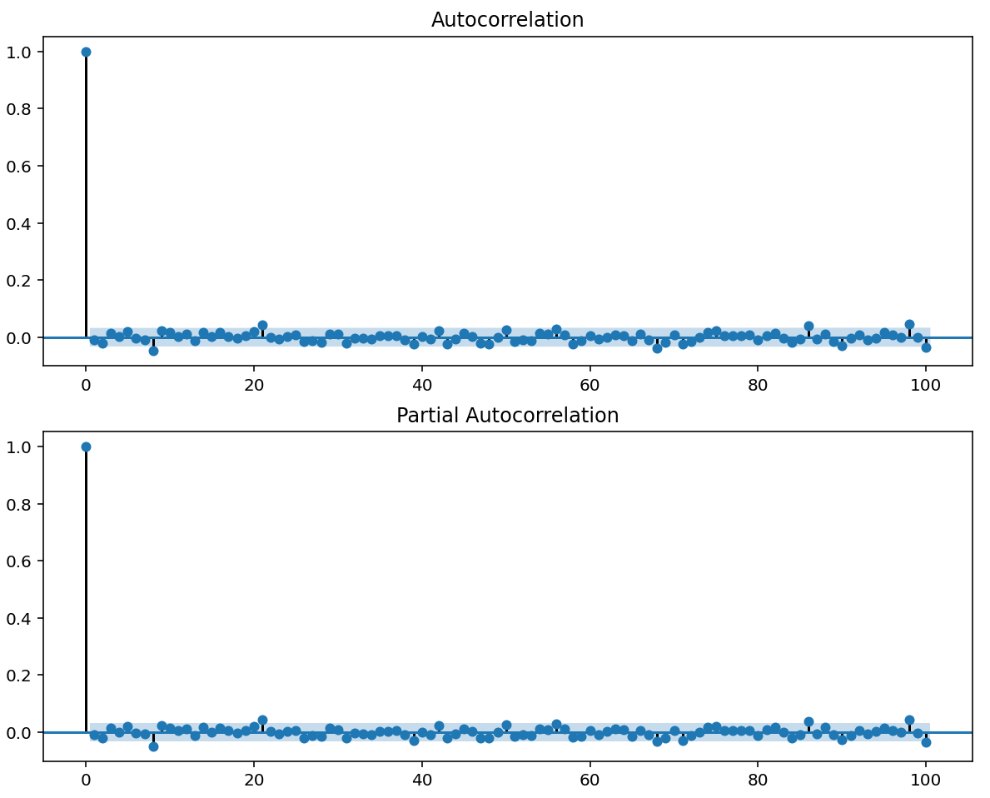
Time Series Analysis cont.
The ACF plot of the differenced data shows no significant correlation between day-to-day changes
Suggests a geometric random-walk with drift might be appropriate

Slide 14
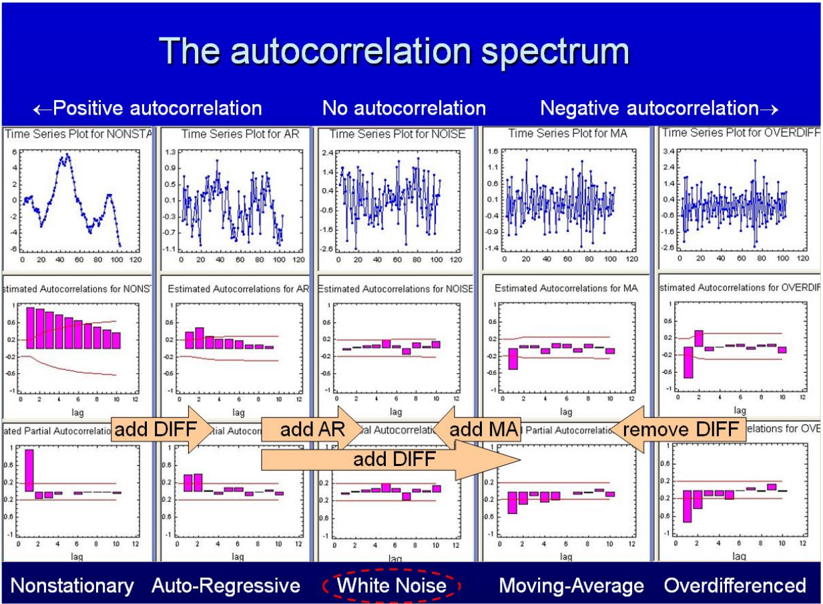
Intuition behind ACF and PACF
Ideally, your residuals will have no autocorrelation
Your model would have captured all the signals
In practice, for non-seasonal data, you only tune for either p OR q
Their effects may cancel one another
Tuning for ARIMA(p, d, q):
Adjust q for spikes at lags 1-3 in residual ACF plot
Adjust p for spikes at lags 1-3 in residual PACF plot
Image taken from https://people.duke.edu/~rnau/Notes_on_nonseasonal_ARIMA_models--Robert_Nau.pdf

Slide 15
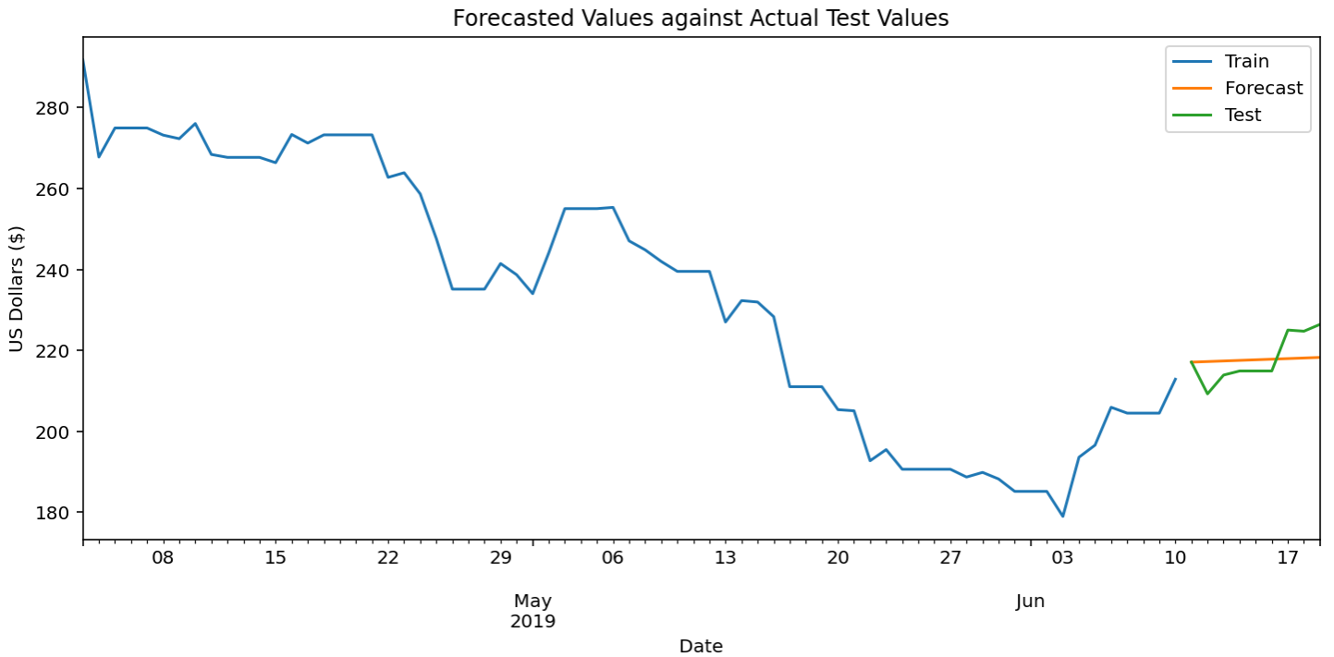
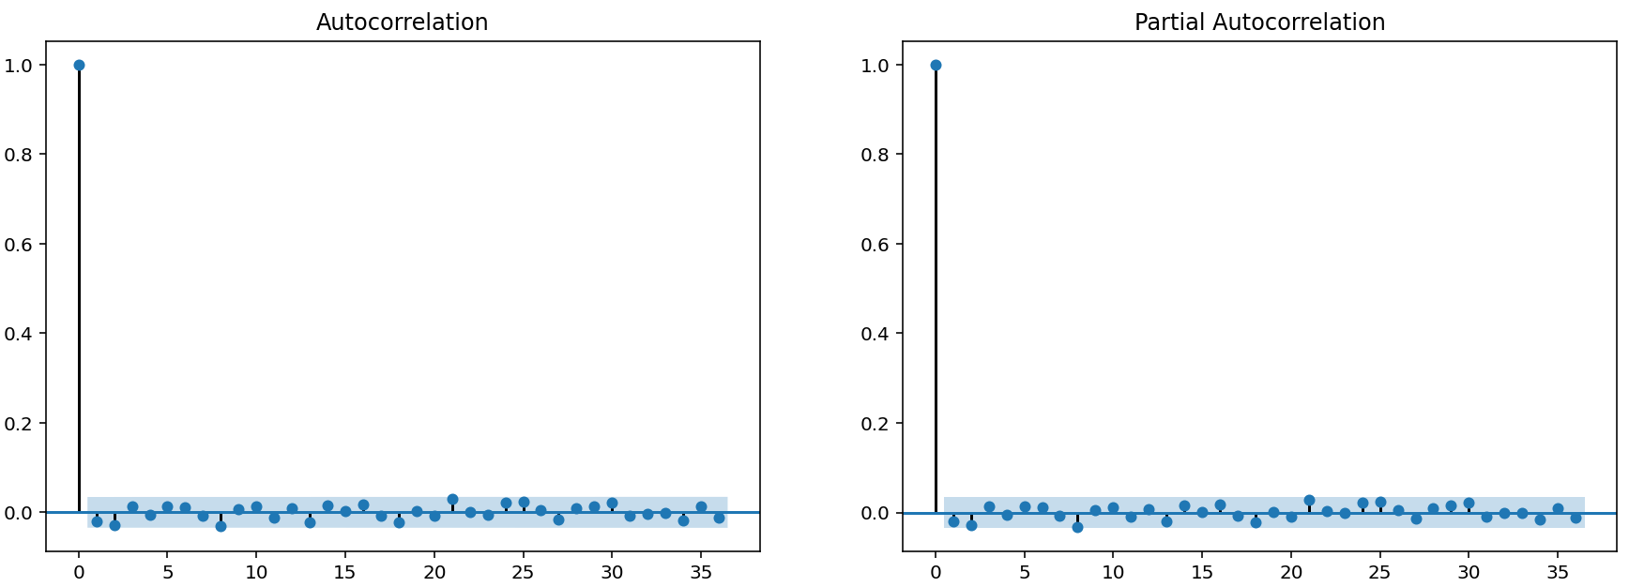
Arima(0, 1, 0) + c Results
Short term predictions converge on the mean almost immediately
Could utilize 95% confidence bands for decision making
AKA Geometric Random Walk
The residuals from this model are uncorrelated

Slide 16
Findings
The element of human behavior cannot be accounted for in a machine learning model
Play the long game with TSLA stock
Burton Malkiel is an economist who theorized that stock prices follow a random-walk process and claims that it is impossible to consistently “beat the market”
Next steps: Add more complexity/dimensionality to my model. Finish LSTM model

Slide 17
REferences
https://people.duke.edu/~rnau/Notes_on_nonseasonal_ARIMA_models--Robert_Nau.pdf
https://blog.usejournal.com/stock-market-prediction-by-recurrent-neural-network-on-lstm-model-56de700bff68#:~:text=The%20prediction%20of%20the%20market,models%20for%20processing%20sequential%20data.

